Slide 1
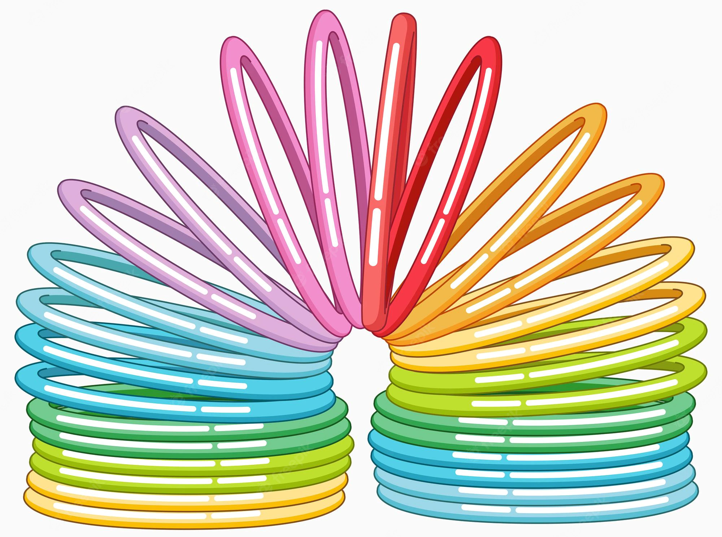
Programming
A Slinky
01
02
Amal Ali Marzooq - 202003891
Raghad Ebrahim Ali Rashid- 202011111
Yaqeen Muneer Kadhem Ahmed - 202002184
03
04

Slide 2
01
Introduction
01
02
03
04

Slide 3
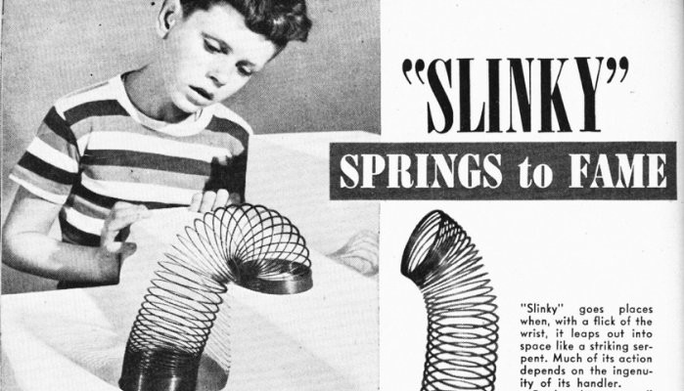
Introduction!
Did you know? The invention of “the slinky” that was designed by a mechanical engineer came by coincidence while he was working on an equipment for navigational ships.
The slinky introduced to the world as a toy!
But physicist have their own distinct point of view!
We physicist always look beyond..here we opened our brains and simulate three phenomena of the slinky using fortran programming language>>
01
02
03
04

Slide 4
The Vertical
hanging slinky
The two end
Suspended Slinky
The Free-Falling
Slinky

Slide 5
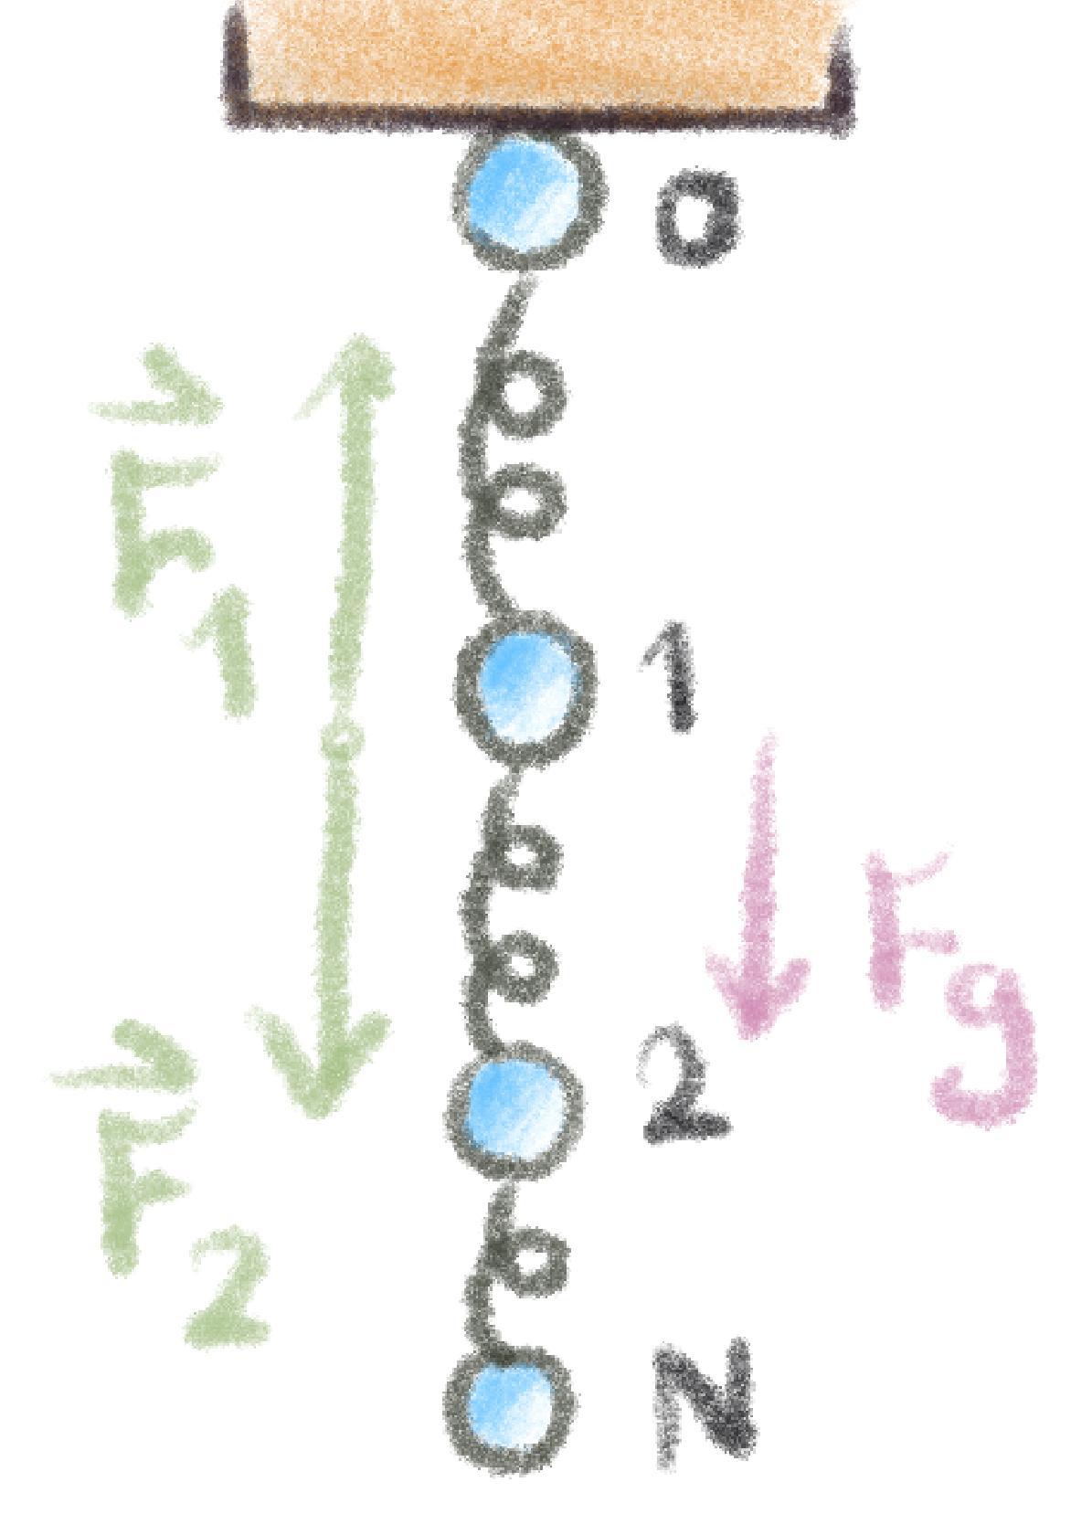
FrameWork
The slinky is modeled as a system of massless springs containing N number of particles with masses m
Each particle is separated by a spring with spring constant k having length L₀
by pursuing the particle positions, and setting the forces along the x-y-axes for each particles, we simulated a program that predict the slinky motion!

Slide 6
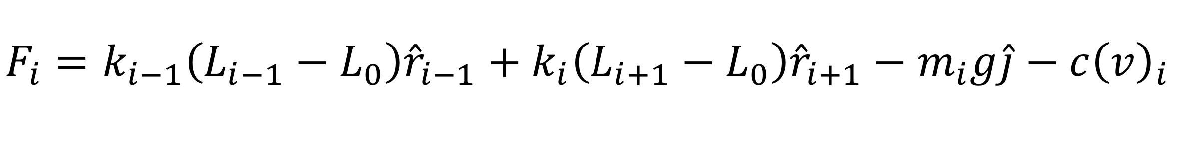
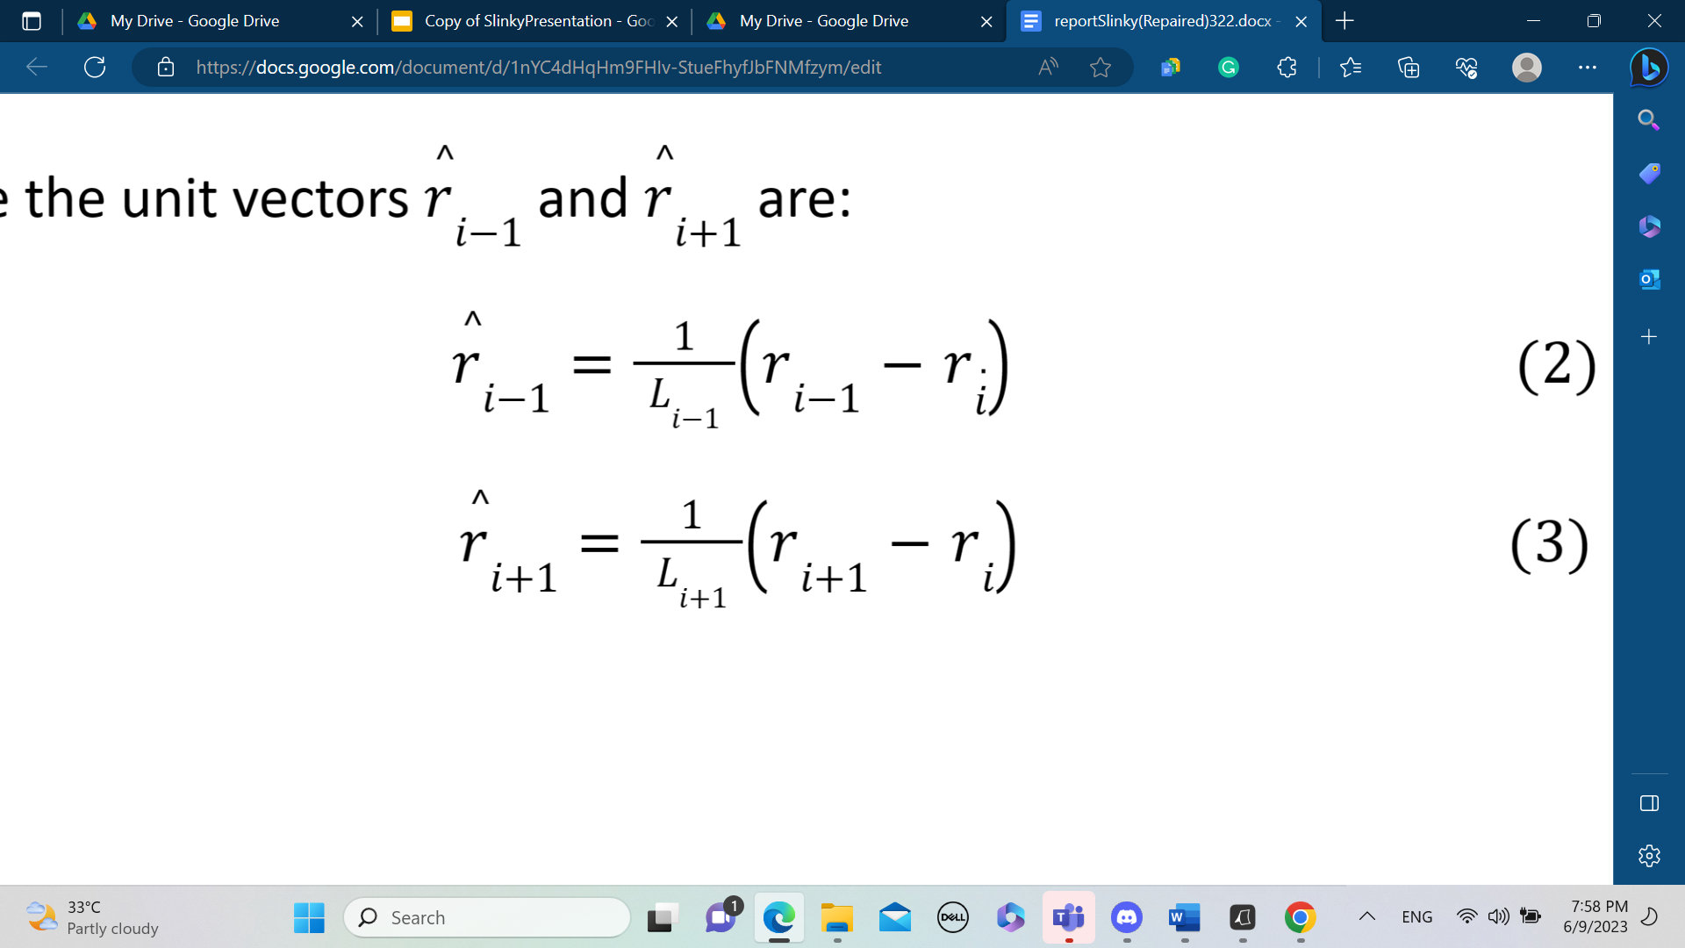
The physics behind a slinky!
The Net Forces acting on the slinky is given by:
Where the unit vectors are:
(1)
01
(2)
(3)
02
To damp the oscillations, an air friction term was added to the equations to activate the damping force.
03
The slinky’s motion considered to be slow, Thus the force is proportional to (v).
04

Slide 7
Numerical Approach
Euler Method
Simple Euler assume that velocity & acceleration do not change significantly with time
01
Euler-Cromer Method
02
Euler-cromer uses the current velocity to update position at each time step ∆t.
03
Conservation of Energy
For conservative systems , the Energy must be constant. So, Euler-Cromer was used.
04

Slide 8

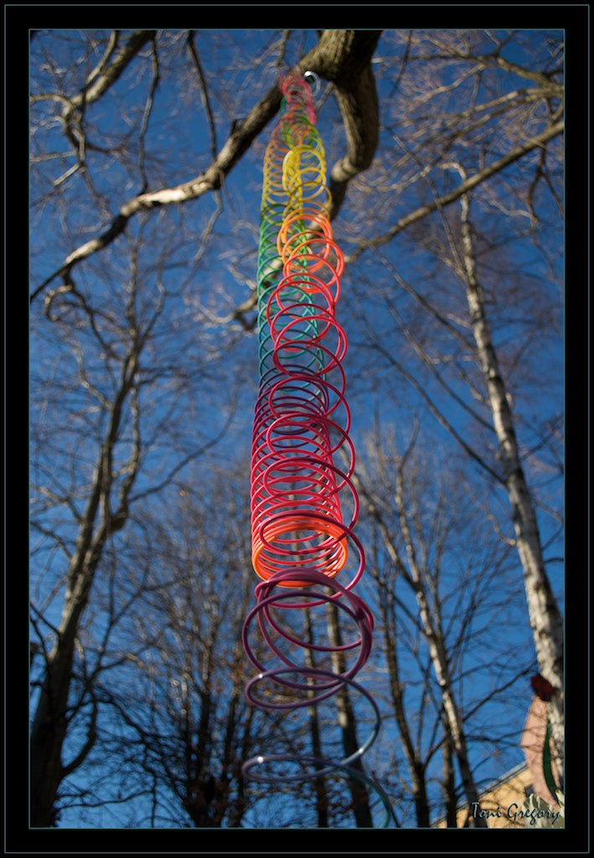
02
Vertical Hanging
01
02
03
How can we model a vertical hanged slinky and let it fall freely?
04

Slide 9
Our Considerations and parameters:
Spring Constant and particle mass
Damping Force
The Drag coefficient was estimated to be roughly c = 5x10⁻³
The spring constant k was choose to be k=20N/m
The spring is has masses m=1g.

Slide 10
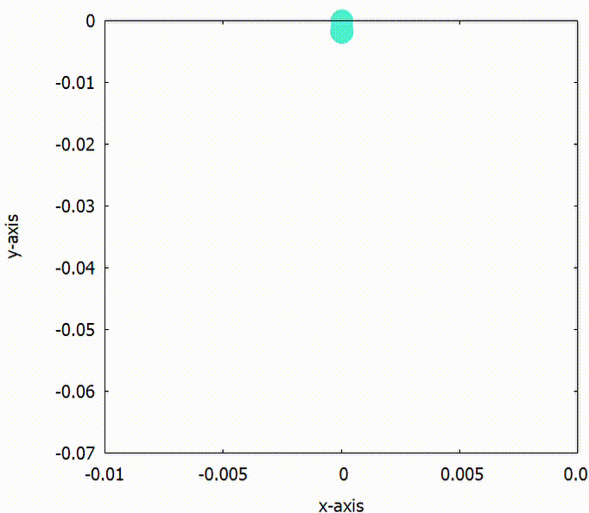
Vertical Hanging Slinky
The motion of vertical hanging slinky
01
Oscillation System
02
The slinky will stretch and compress in the form of a simple harmonic damped oscillator
03
The animation above display the coordinates of N=10 in the x-axis and y-axis.
04

Slide 11
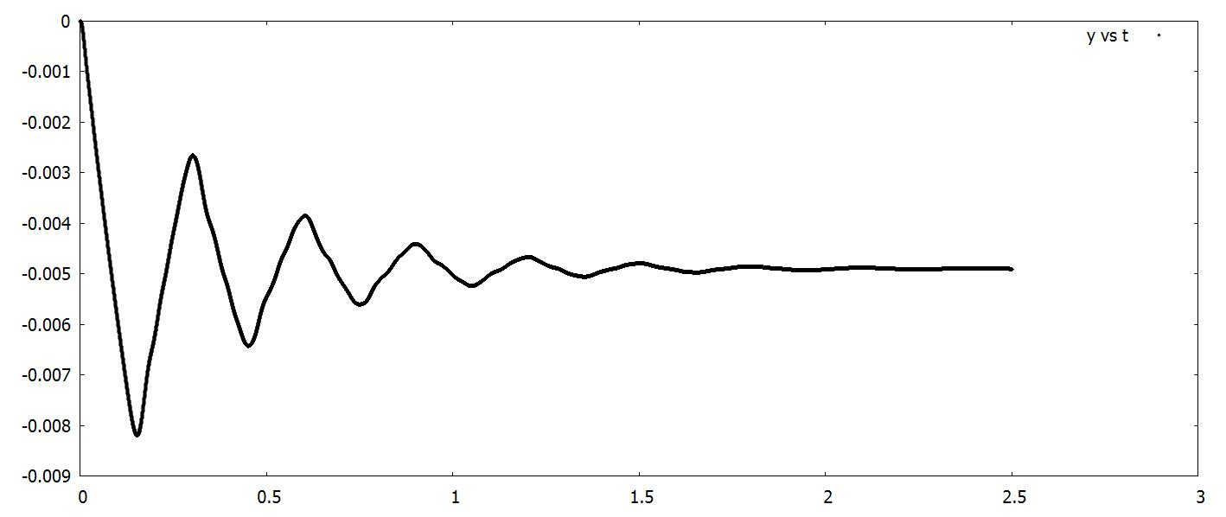
We can Deduce>>
The position of each particle along a period t = 2.5 s
Y (m)
Time (s)
For N = 10 particles with masses of m = 1g and spring constant k = 20N/m
The slinky will oscillate and reach it maximum elongation length and then gradually damped, until it reach it equilibrium length and eventually stopped oscillating and moving!

Slide 12
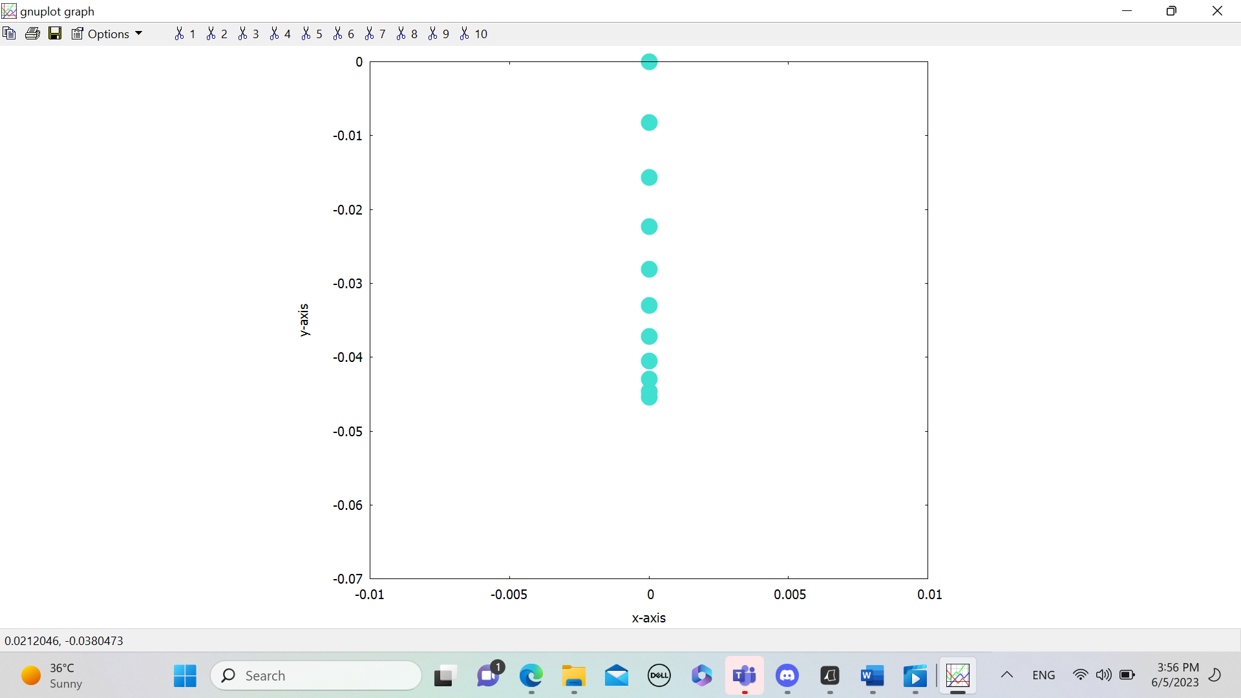
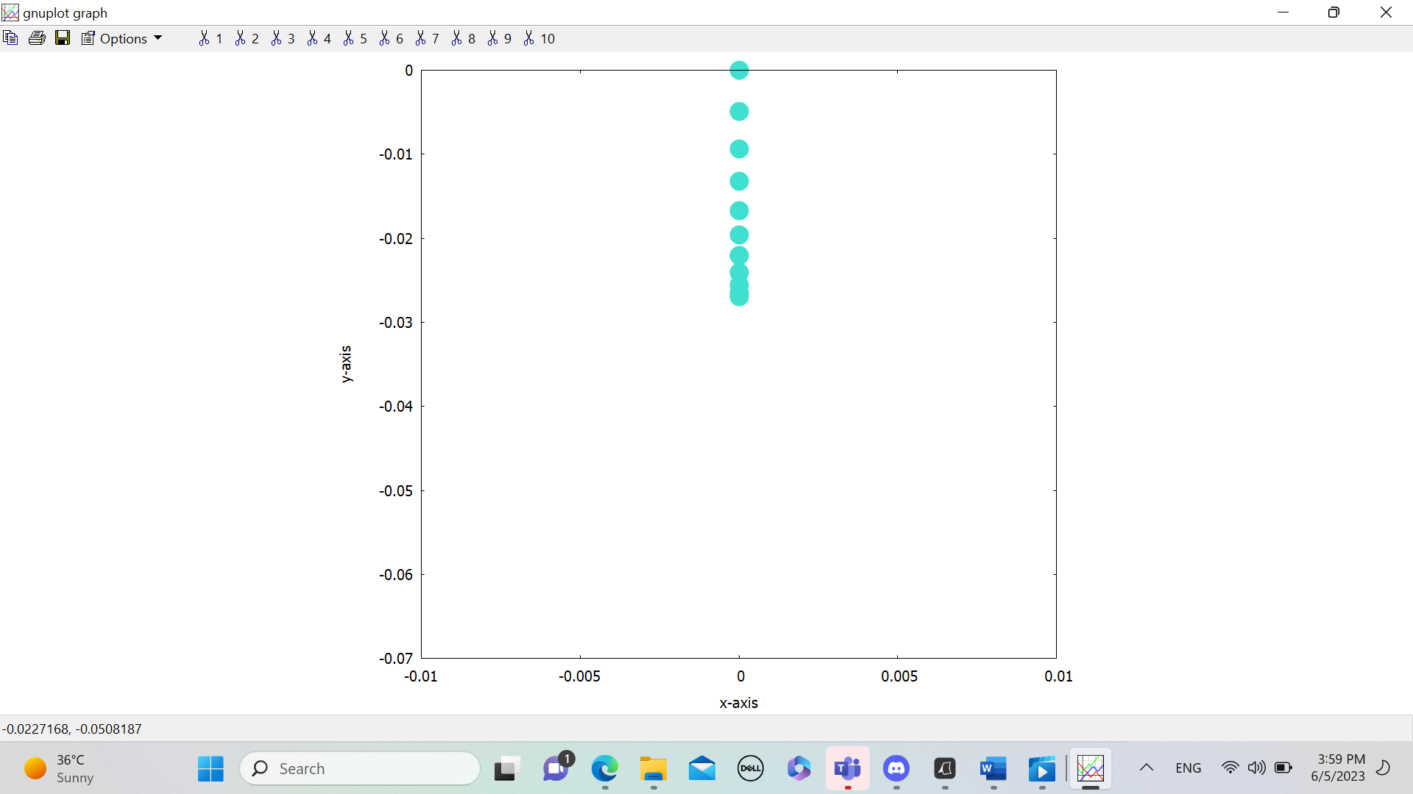
Conservation Of Energy
The maximum elongated length
The equilibrium elongated length
y-axis(m)
y-axis(m)
y-axis(m)
x-axis(m)
x-axis(m)
due to the conservation of energy the maximum elongation for the total slinky cannot exceed that of the first oscillation.
The total elongation length is decreasing gradually due to the damping force acting on the slinky model(Energy loss).

Slide 13
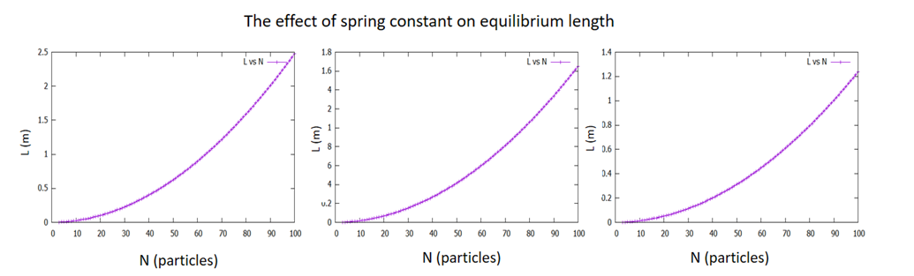
The slinky’s stiffness and the equilibrium length!
(a) K = 20 N/m (b) k = 30N/m (c) k = 40N/m
As it shown above, The smallest value of the slinky constant K=20N/m , have the highest equilibrium length. While having larger value k=30N/m showed less equilibrium length, and the largest spring constant K=40N/m have the smallest value of the total elongated length!

Slide 14
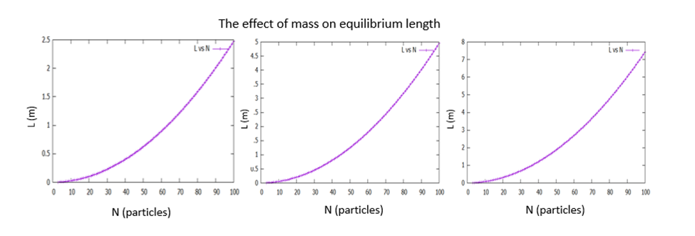
The particles masses and the equilibrium length!
(a) M = 1g (b) M = 2g (c) M = 3g
By Increasing the particles masses, the equilibrium length will be longer, according to the weight of the slinky.

Slide 15
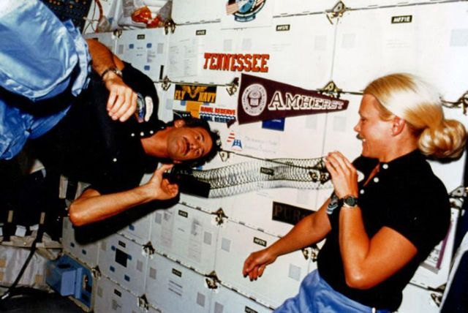
A Gedanken experiment:
What if a slinky was brought to the moon?
We examined moon’s circumstance on our slinky model with m=1g and k=20N/m
Note: Fun fact but this is a real picture for a slinky had taken to space in 1985:
01
02
03
04

Slide 16


Earth Vs Moon
01
01
Earth
Gravitational Acceleration | 9.8m/s^2
Air Resistance | Exist. it did play a role
Moon
Gravitational Acceleration | 1.6m/s^2
Air Resistance | Negligible, (No atmosphere)
02
02
03
03
04
04

Slide 17
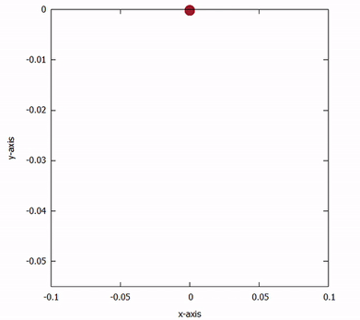
The Lunar Slinky Motion
The motion of vertical hanging slinky
01
Oscillation System
The Slinky Elastic property will keep its oscillation. The animation showed a free oscillation for the lunar slinky, where there’s no damping acting on it.
y-axis(m)
02
03
x-axis(m)
04

Slide 18

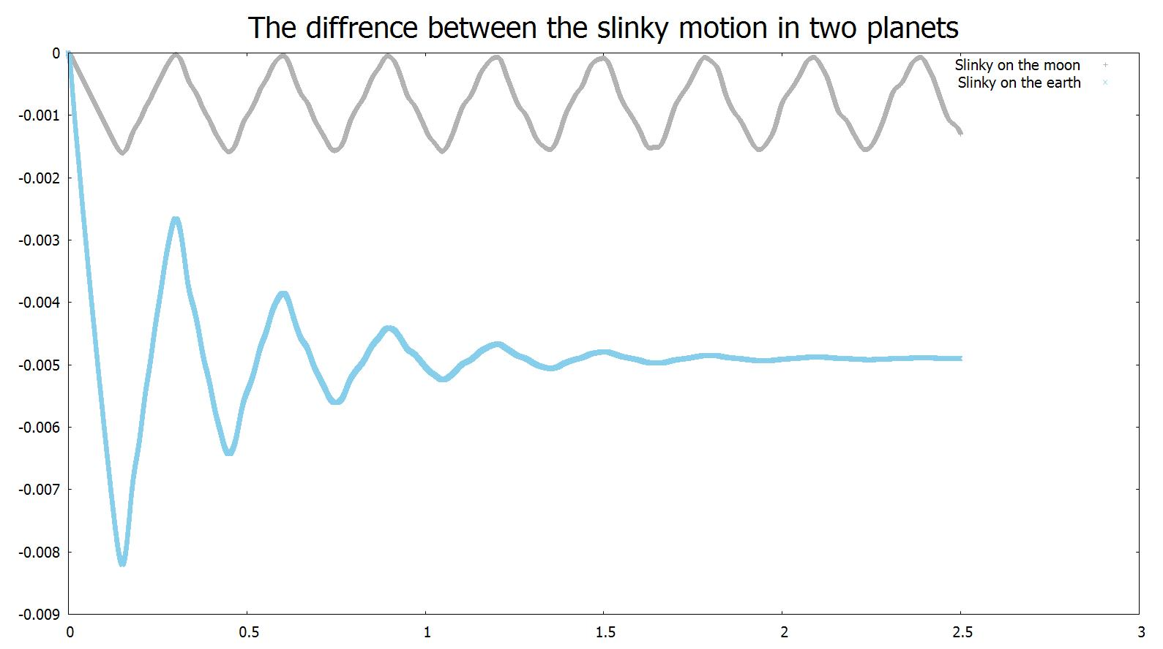
Our observations for our lunar Slinky:
y-axis(m)
01
02
03
Time (s)
For slinky with k=20N/m and particle’s m=1g, The ‘sky blue’ shows the slinky model on earth, while the ‘grey’ trajectory shows the slinky model on moon surface.
04

Slide 19


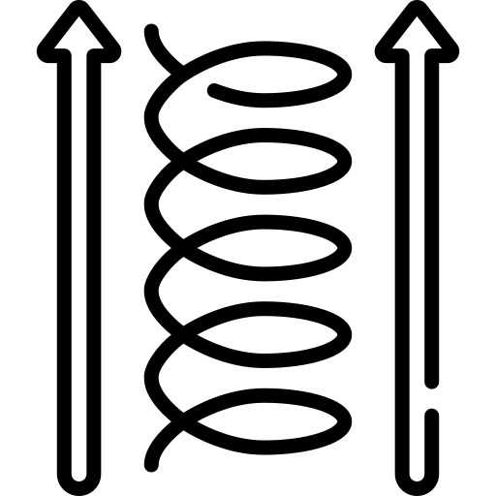
To Conclude..
01
The Total Elongation
the total elongation length (the amplitude of oscillation in the graph) on the moon is shorter
The damping Force
02
The lack of atmosphere will prevent air resistance from damping the motion.
Thus, the slinky will oscillate forever!
The oscillator's Frequency
03
The oscillation period would remain the same, Since the Slinky’s stiffnesses is the same in both cases
04

Slide 20

Catenary-like Curves
03
01
02
03
04

Slide 21
3.1
The Suspended Slinky Shape
01
02
03
04

Slide 22
Consider a Suspended slinky between two fixed ends (mN and m0)

Slide 23
This slinky will take a curve similar to the catenary curve
BUT
NOT EXACTLY THE SAME
01
02
03
04

Slide 24
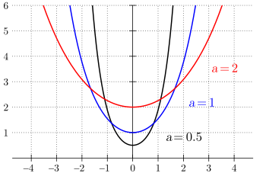
But What is a Catenary-Curve?
It’s a Hyperbolic Cosine function curve :
Where (a) is the catenary constant
01
02
y= a cosh (x/a)
03
04

Slide 25
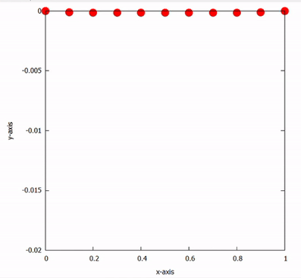
Initially
N=10 particles, k= 20 N/m & each mass = 1 gram
let the slinky move under its own weight only
Animation of Suspended Slinky
01
02
y - axis (m)
03
04
x - axis (m)

Slide 26
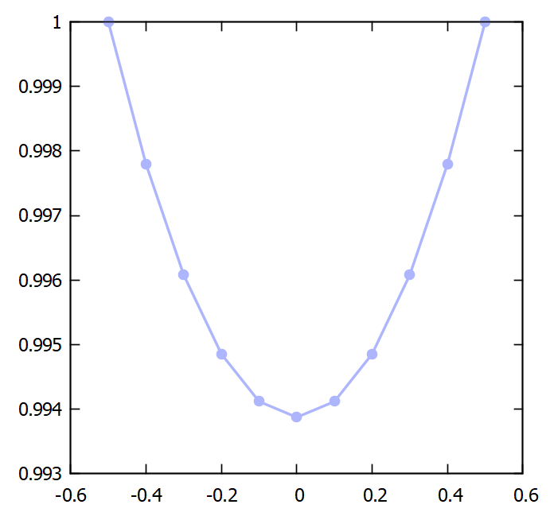
Horizontally Suspended Slinky
01
y - axis (m)
02
03
04
x - axis (m)

Slide 27
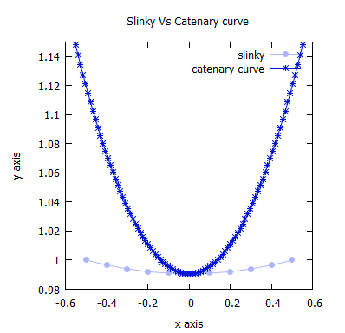
Initially
N=10 particles, k= 20 N/m & each mass = 1 gram
The Slinky didn’t match Catenary curve because :
01
Non-Continuous mass distribution .
Center of Mass has the freedom to be lower than Catenary curve
02
03
04

Slide 28
3.2
Limits Approaching true Catenary Curve
01
02
03
04

Slide 29

A True Catenary Curve
Let’s ask ourselves!

Slide 30
To reach a True Catenary Curve we changed
01
1
2
3
4
02
N=1000 particles
k=9800 N/M
l0= 1mm
Changing the mass accordingly
To get a saturated slinky
To reduce stretching
Adding some initial length
03
04

Slide 31
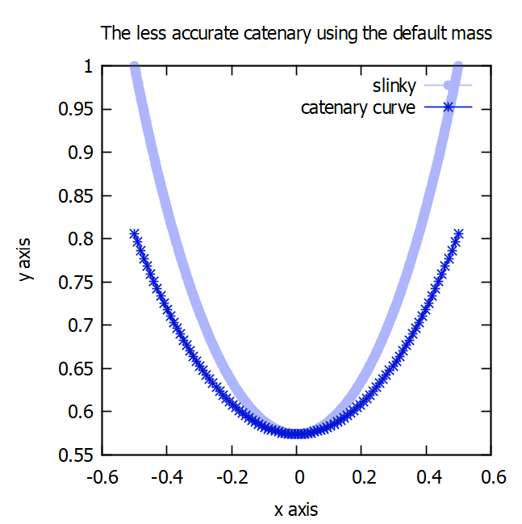
Attempts on getting a catenary-like curve
01
1- Using default mass
m = 1 gram
02
03
04

Slide 32
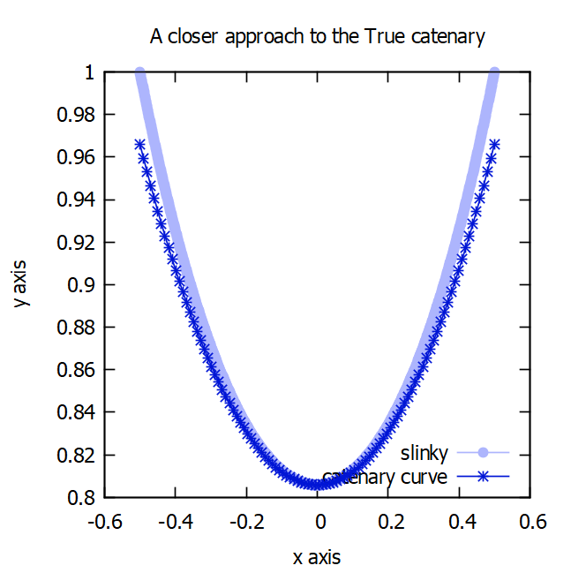
Attempts on getting a catenary-like curve
We notice as we decrease mass it will get more-like catenary curve
01
02
2- Using less mass
m = 0.17 gram
03
04

Slide 33
Attempts on getting a catenary-like curve
As you can see we’re getting closer and closer to our goal
01
02
Lastly, Using even less mass we got the closest approach when
m = 0.127 gram
03
04

Slide 34
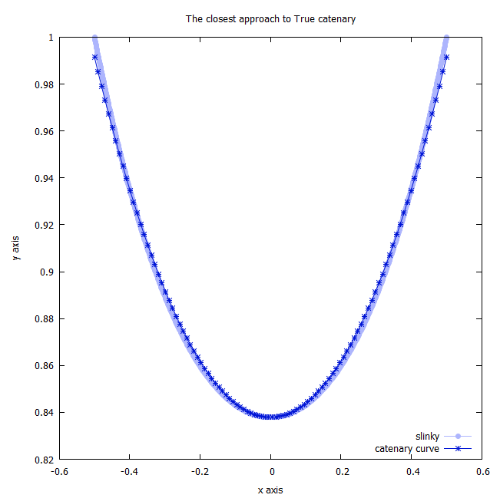
The closest approach to True catenary
01
y - axis (m)
02
03
04
x - axis (m)

Slide 35
3.3
Variable Masses
01
02
03
04

Slide 36


What if we variate the masses instead of of having uniform mass ?
Will the shape of the slinky change ?
Let’s find out!

Slide 37
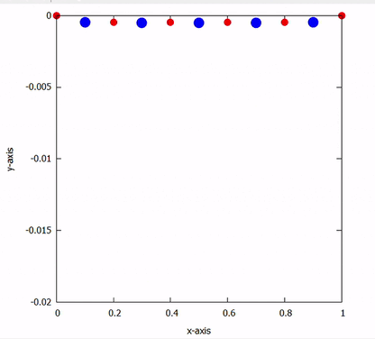
Variable Masses Animations
For odd particles m = 2 g
y - axis (m)
Variable
Masses
For even particles m = 1 g
x - axis (m)

Slide 38
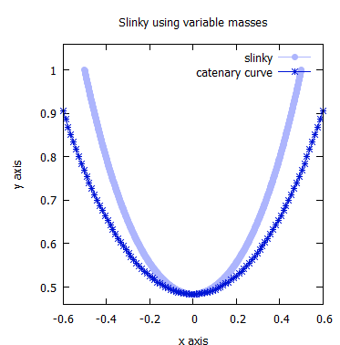
The slinky will deviate from the true catenary because of the non-uniform mass distribution
01
02
03
04

Slide 39
3.4
A Slinky Dog !
01
02
03
04

Slide 40
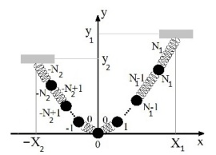
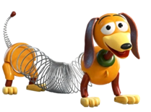
What if we suspended the slinky from points with different heights ?
Will it affect the center of mass and the overall shape ?
01
This question was inspired by “Slink” , the slinky dog from the movie “Toy Story”
02
03
04
Eskandari-asl, "Some Static Properites of Slinky," European Journal od Physics, vol. 39, 2018.

Slide 41
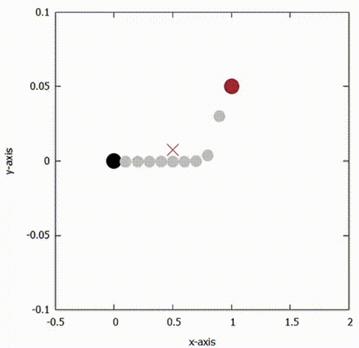
Our Observations:
Slinky dog motion
The center of mass was shifted toward m0 “The tail of Slink”
y - axis (m)
x - axis (m)

Slide 42
Dynamics
04
01
02
03
04

Slide 43
4.1
Falling Slinky
01
02
03
04

Slide 44
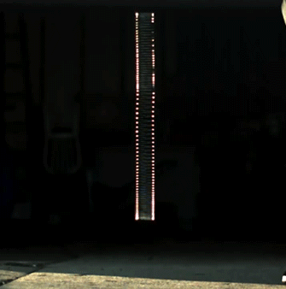
Consider “dropping” the slinky!
01
02
03
04

Slide 45
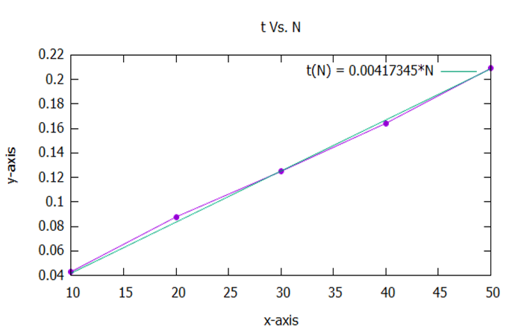
Investigation for the time required for mN to move
01
a suitable tolerance for each corresponding number of particles was chosen.
02
The graph exhibits the relationship between the number of particles (N) and the time t(N) that takes the bottom particle to move.
03
04

Slide 46
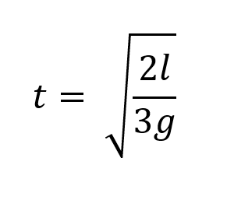
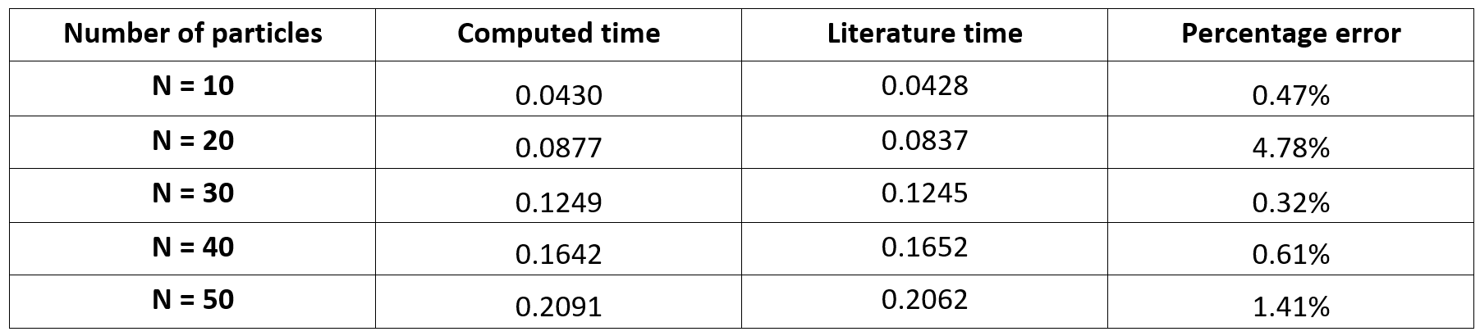
Comparing the findings with literature
The time t that it takes the last particle in the slinky to move was approximated to be:
01
When the results were put together with the theoretical ones:
02
03
04

Slide 47
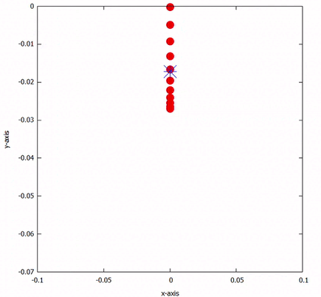
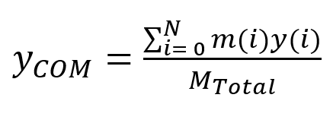
The motion from the COM perspective
The center of mass for the slinky was calculated using:
y-axis
x-axis

Slide 48
4.2
Jiggle-Jiggle!
01
02
03
04

Slide 49
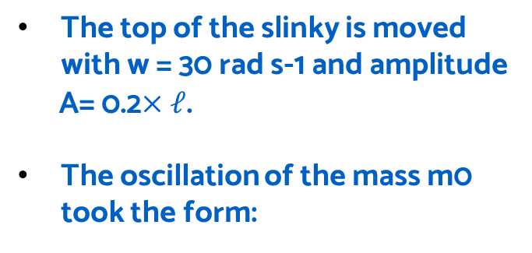
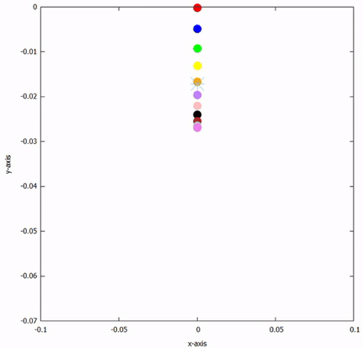
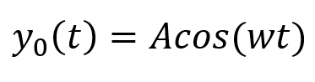
Jiggle-Jiggle!
The motion with the COM
y-axis
x-axis

Slide 50
Jiggle-Jiggle!
Since the particles are dimensionless, no collisions can occur between successive particles.
The frequency of successive particles can match, which can make them resonate.
Some particles can jump and go higher than their former neighbor in sequence (or vice versa).
The motion with the COM
y-axis
x-axis
Which makes Dr. J.A’s model inefficient!

Slide 51
4.3
Snail-like Slinky
01
02
03
04

Slide 52
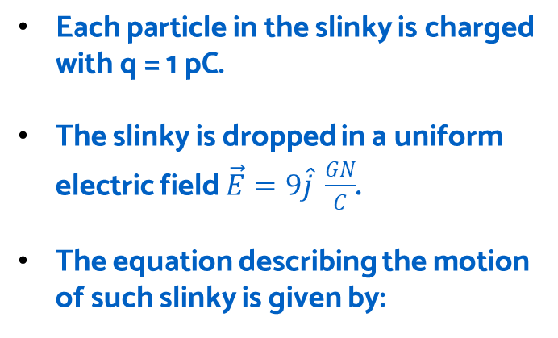
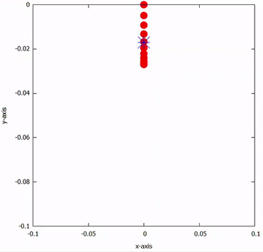
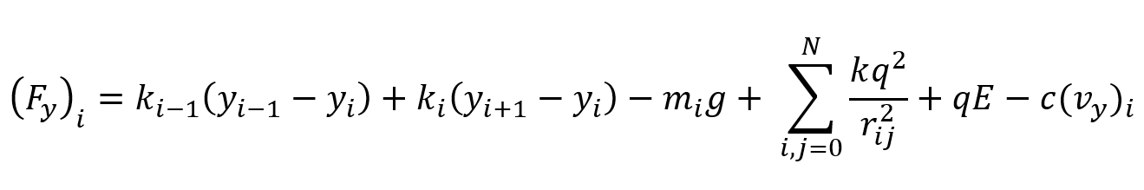
Snail-like slinky
The charged slinky in E
y-axis
x-axis

Slide 53
Snail-like slinky
The charge of each particle is very small in a way that the interactions between particles due to their charges are minute.
When the distance between the particles is sufficient for the repulsion to occur, the particles repel and the slinky is stretched.
Then, the particles are pulled under their own weight, then collapsing over again.
The charged slinky in E
y-axis
x-axis

Slide 54
Future work
01
Freely dropped suspended slinky
Dynamics in fluids
Relation between k&T
02
Implementing the code for freely-dropped suspended slinky as the vertical one- comparing our adopted model with the real slinky toy
Study the relationship between the fluid that the slinky moves in (e.g., water, oil, honey, etc.) and the corresponding dynamics
Examine the relationship between the stiffens of the springs and the period of oscillations for different number of masses
03
04

Slide 55
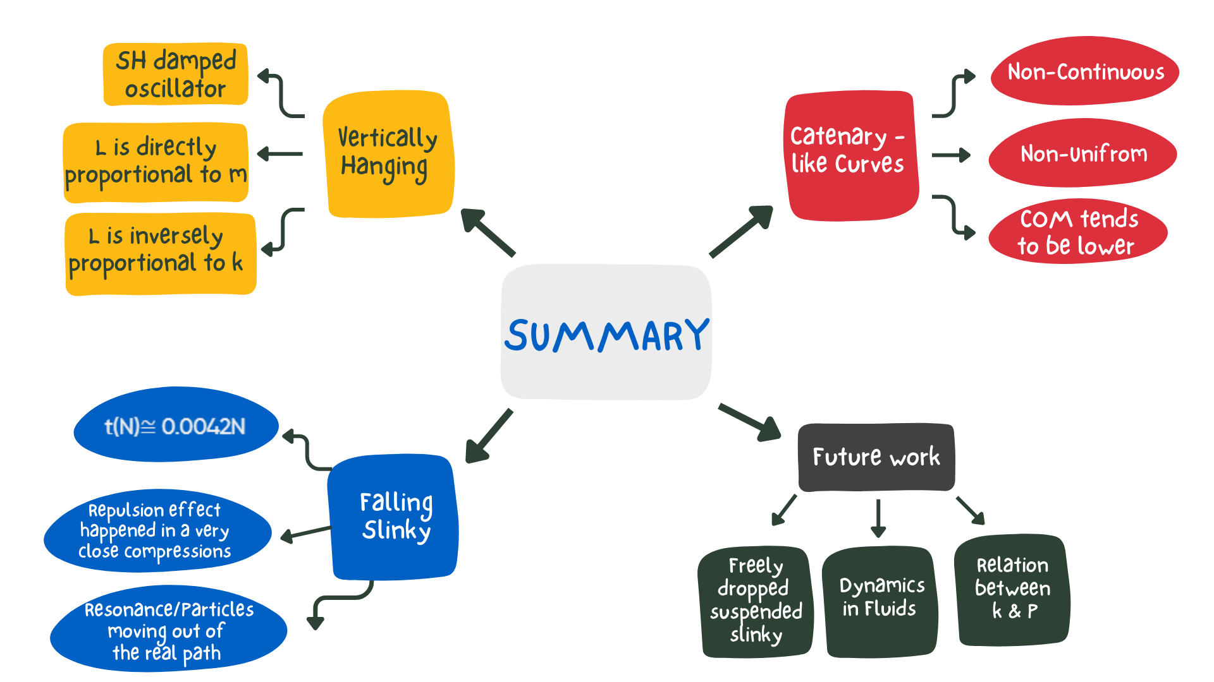
01
02
03
04

Slide 56
Work distributed
Our work was a combination between teamwork and individual work, in particularly, each team member concentrate on:
01
Amal Marzooq
Raghad Ebrahim
Yaqeen Muneer
02
Studying and Interpreting The Free-Falling Slinky and its Dynamics, with graphs, animation and results .
looking for relatable literature.
Studying The Vertical Slinky results, interpreting it with graphs, animations.
Looking for relatable literature.
Catenary-Curve like Slinky, interpreting the investigation with graphs, fitting and animation.
Enhance the precision for the coding part
03
04

Slide 57
Thank you for listening!
01
02
Any Questions?
03
Presented with love,
Amal , Yaqeen & Raghad
04

